Slide 1
Variant Identification and Interpretation from Next Generation Sequencing
Bioinformatics Unit Seminar Series
Tuesday, May 28th
Seth I. Berger, MD, PhD
Assistant Professor
Center for Genetic Medicine Research, Children’s National Medical Center
Rare Disease Institute, Division of Genetics and Metabolism, Children’s National Medical Center
Department of Genomics and Precision Medicine; and of Pediatrics, GWU SMHS

Slide 2
Objectives
Overview of Next Generation Sequencing
Variant Identification Tools and Pipeline
Variant Interpretation

Slide 3
Next Generation Sequencing
Next-generation sequencing refers to non-Sanger-based high-throughput DNA sequencing technologies.
Millions or billions of DNA strands can be sequenced in parallel
More throughput and minimizing the need for the fragment-cloning methods that are often used in Sanger sequencing of genomes

Slide 4
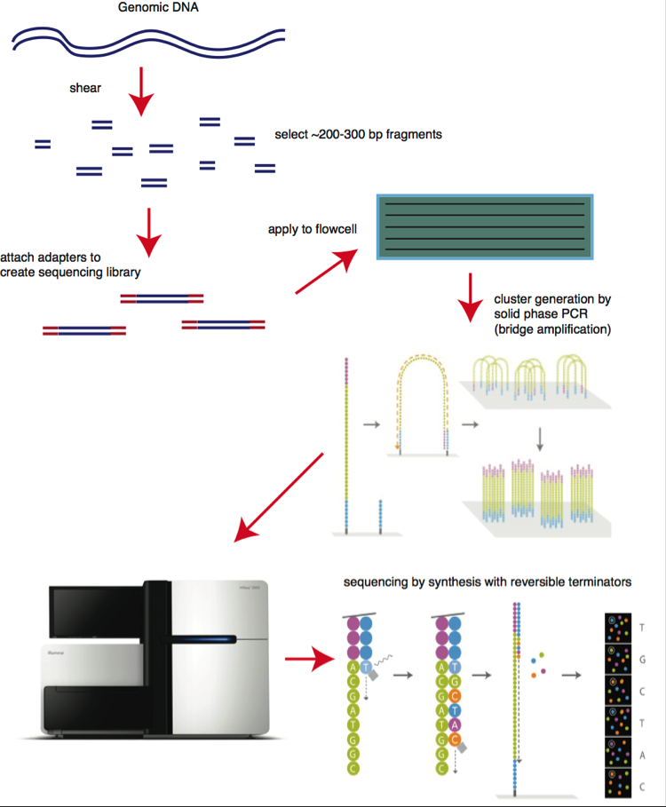
Sequencing
Purpose: Sequence bases identification
4 Steps:
Library preparation
Cluster generation
Sequencing
Data analysis

Slide 5
Bioinformatic Workflow
Sequencing
Quality Check
Analysis
Store

Slide 6
Definitions
Reads: inferred sequence of base pairs corresponding to a part or a whole DNA
Raw data: Formatted Sequence of DNA/RNA/AA
Paired ends: Forward and reverse read of same cluster
Pipeline: structured execution commands

Slide 7
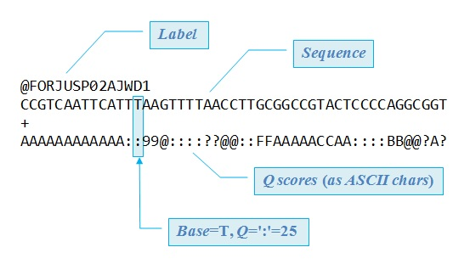
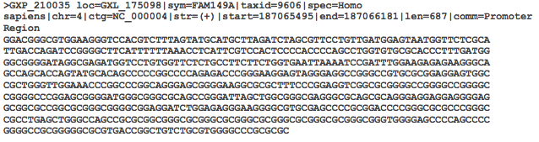
Files description
FastA format
FastQ format
Header
Sequence
Header
Quality score
Sequence

Slide 8
Alignment
Burrows-Wheeler Aligner (BWA)
Map low-divergent sequences against a large reference genome.
SOLiD
Illumina
IonTorrent
Sanger
Assembly contigs
PacBio
BACSeq
454
BWA
BWA-backtrack
Reads<=100bp
BWA-SW
70bp<r<1Mbp
BWA-mem
Fast and accurate, best performance in most cases

Slide 9
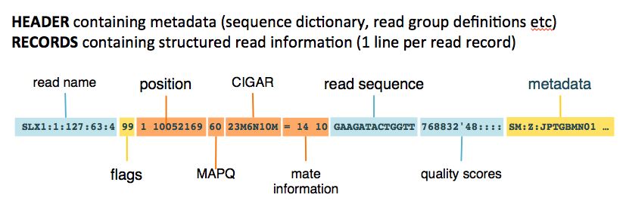
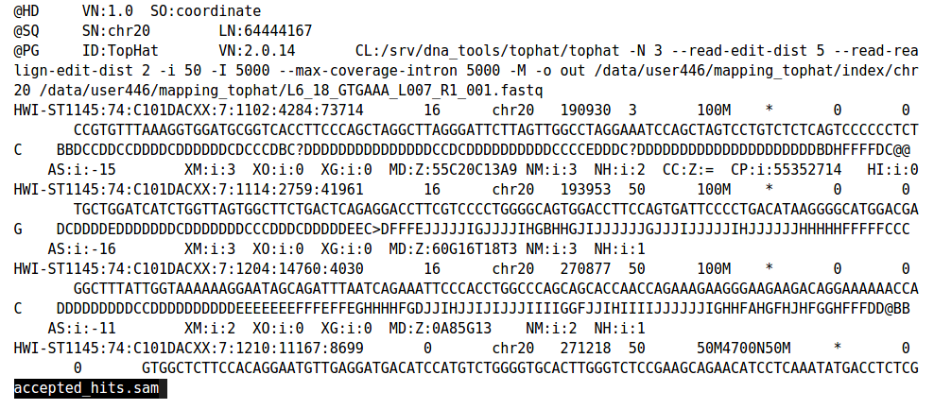
Files description
Sequence Alignment Map format (SAM)
Alignment
Quality Scores
Read
Sample information
→ Data compression
BAM
CRAM

Slide 10
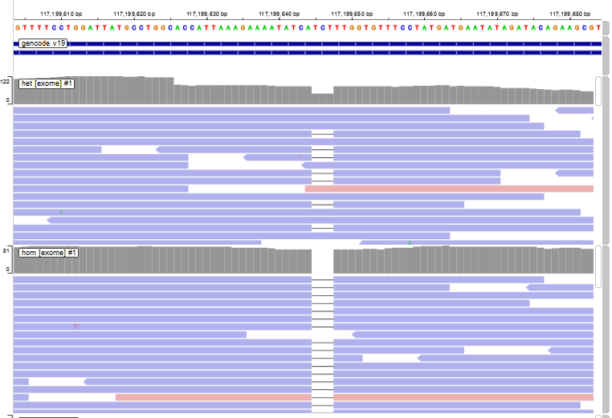
Variant Pileups
Viewed in IVG
Example heterozygous and homozygous 3 base pair deletion

Slide 11
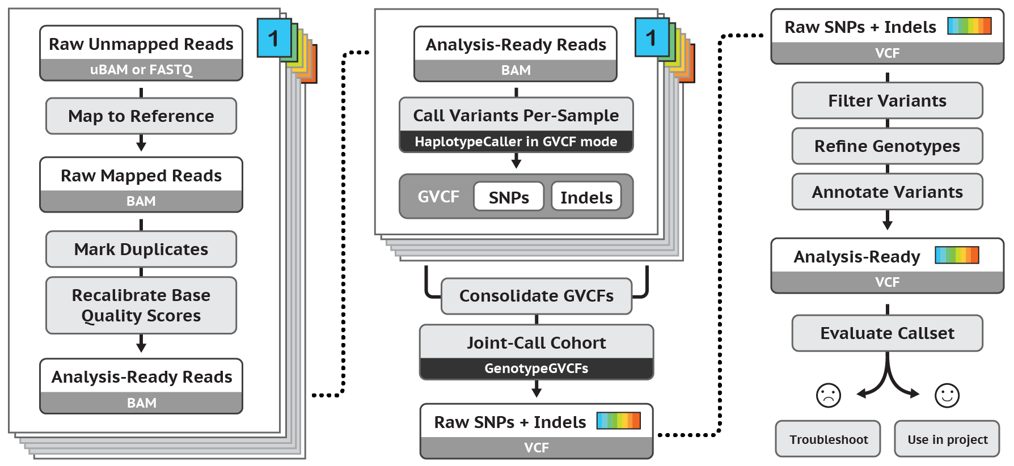
Variant Calling
Statistically call variants from aligned sequences
GATK Haplotype Caller, Platypus, etc
Calls SNVs and Indels

Slide 12
Other Types of Variant Calling
Copy Number Variants
Depth of coverage (XHMM, etc)
Aberrant Mate Pair Insertion size (Mseq)
Translocation
Aberrant Mate pair distribution (Breakdancer, etc)
Mosaic Variants
LoFreq, Mutect2, etc
Most clinical pipelines are optimized for germline variants
Other specific variant callers can be integrated into pipeline

Slide 13
File format description: Summary
Formats | Input for | Output from
FastA | BLAST Multiple Sequence Alignment (MSA) Database query tools | Older Sequencers Sequence Database store Converters
FastQ | FasQC Aligners Assemblers Variants detection/SNP callers | Sequencers (default format) Format Converters
SAM/BAM/CRAM | Alignment algorythms Some Assemblers Alignment viewers Variants detection | Aligners Assemblers
VCF | VCF tools SNP Annotation | SNP caller Haplotyping Software Variant Information Database
BED/BEDGrap | Alignment viewers Bed tools Some annotation | Features detection

Slide 14
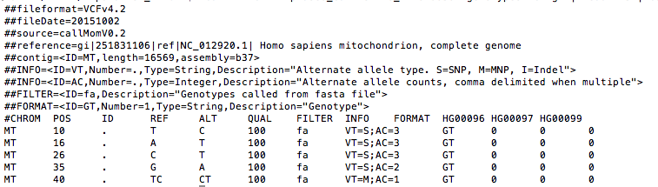
Files description
Variant Calling Format (VCF)
Shows variants, not genetic features.
Can have additional per variant and per sample annotations

Slide 15
Annotation
ANNOtate VARiants (ANNOVAR)
SNP Effect (SNPEff)
Program for functional annotation.
Can identify Structure variants and examine functional consequences on gene.
Disease identification.
All species.
Program for annotating and predicting the effects of SNP.
Annotate thousands variants/sec.
Based on the genomic position.
Many species.

Slide 16
Objectives
Overview of Next Generation Sequencing
Variant Identification Tools and Pipeline
Variant Interpretation

Slide 17
Clinical Variant Interpretation
Clinical versus Research Variant Interpretation
Cautions about variant interpretation
ACMG Reportable Secondary Finding Genes
ACMG Variant Classification Guidelines

Slide 18
Clinical vs Research Variant Interpretation
Research Variant Interpretation
Association of variants to Phenotype
Note: GWAS variants are not necessarily disease causing, typically linked to a truly pathogenic variant
Functional effects of variants
Molecular function, pathways, structure, localization, etc…
Clinical Variant Interpretation
Does this variant cause a phenotype?
Does this variant change what the doctor does clinically?
Is more testing needed for this patient or does variant provide an answer?
Can family make reproductive decisions based on variant?

Slide 19
Cautions about variant interpretation
Proving a variant causes functional changes in a protein does not mean it is clinically relevant.
Models may not always be able to recapitulate a phenotype.
Example: MTHFR: 1298A>C
Originally studied as possible contribution to thrombosis
Functional studies showed variants with somewhat decreases/altered activity
Multiple conflicting studies linking to many different things from autism to cancer.
Found to be very very common in population at large
Some families refusing vaccination based on this or spending money on expensive supplements without known clinical benefit…

Slide 20
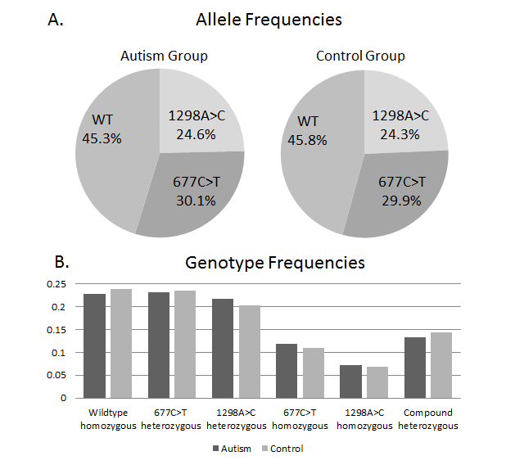
MTHFR Common Polymorphism Frequencies at CNMC

Slide 21
What variants get reported clinically?
Varies from lab to lab
Depends on test ordered:
Targeted gene tests/panel
Untargeted tests (exomes, genomes)
Prenatal / Postnatal
Screening vs. Testing
Carrier status?
Secondary findings?

Slide 22
ACMG Reportable Secondary Findings
ACMG curated list of genes where pathogenic variants in a healthy individual would change medical management
Cancer susceptibility genes with early screening options
Cardiac arrhythmia genes with medication options/possible defibrillators
Serious potential drugs side effects where medication choices may prevent life threatening effects
Treatable inborn errors of metabolism with late onset
Only Pathogenic / Likely Pathogenic variants returnable
May not report uncertain variants
Recommends people be offered option of receiving these results even if these are not included on indication for sequencing.
Some research studies will offer return of these results.

Slide 23
How Clinicians Talk about Variants
Pathogenic → Most likely causes a disease
Describes variant (not genotype)
Likely Pathogenic → Probably related to the disease, but can’t be certain
In right clinical setting, can be considered the answer
Variant of uncertain significance → Not enough evidence to judge
Challenging discussions and clinical reasoning
Likely Benign → No reason to believe it causes a disease, but can’t be sure
Benign → Too Common to cause disease

Slide 24
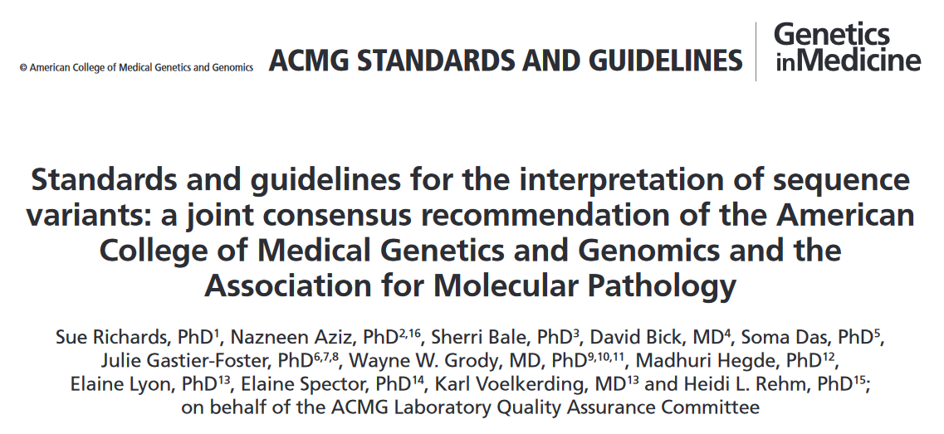
ACMG Variant Classification Guidelines

Slide 25
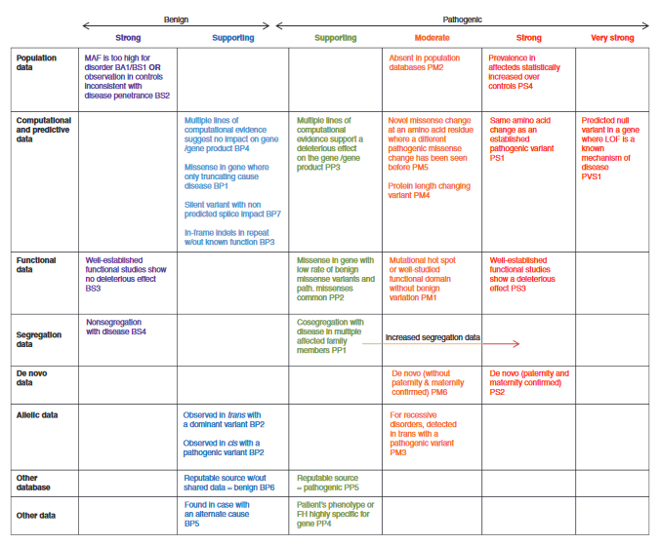
Criteria Overview

Slide 26
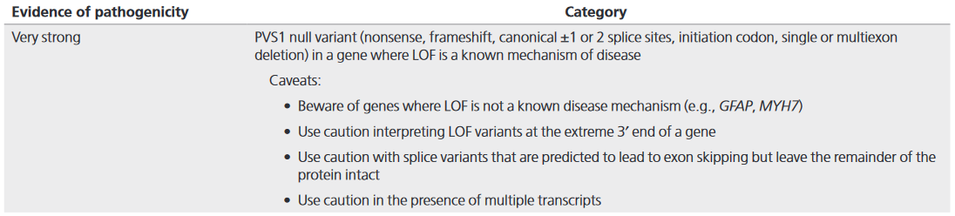
Very Strong Criteria

Slide 27
Note the caveats
Loss of function must be a known mechanism
Variants that escape nonsense mediated decay
Certain disease genes for example WHIM syndrome and FAM83H Amelogenisis imperfecta, truncation mutations lead to gain of function effect which are pathogenic while loss of function mutations are tolerable (at least in a heterozygous state)
In-frame exon skipping
Minor Transcripts

Slide 28
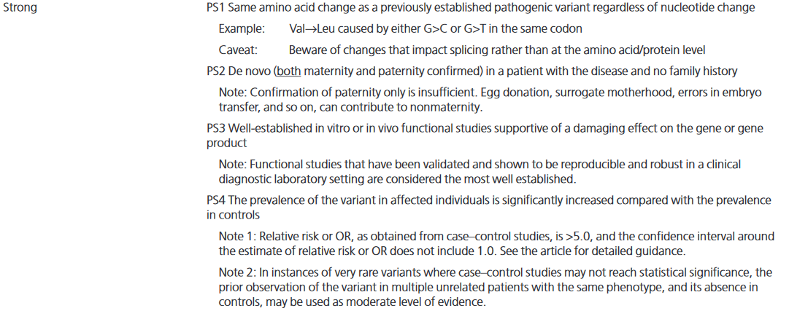
Strong Criteria

Slide 29
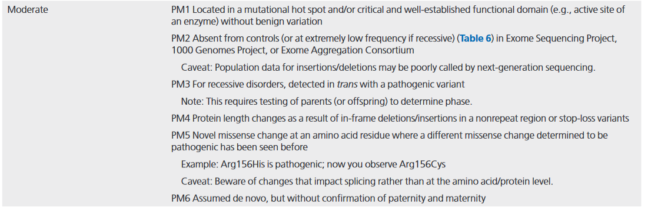
Moderate Criteria

Slide 30
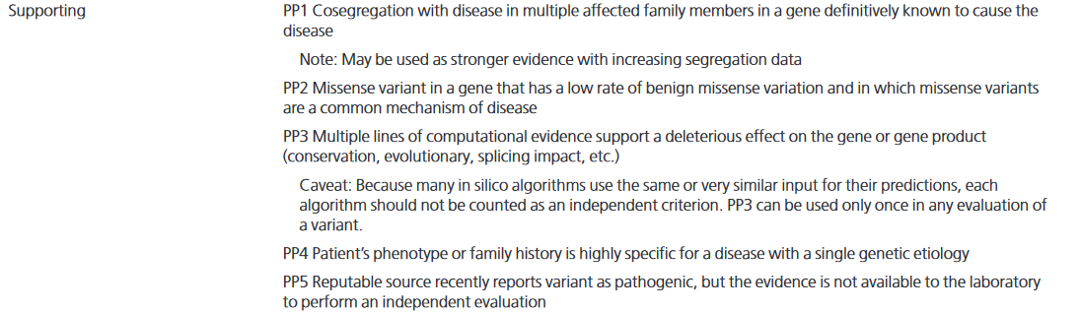
Supporting Criteria

Slide 31
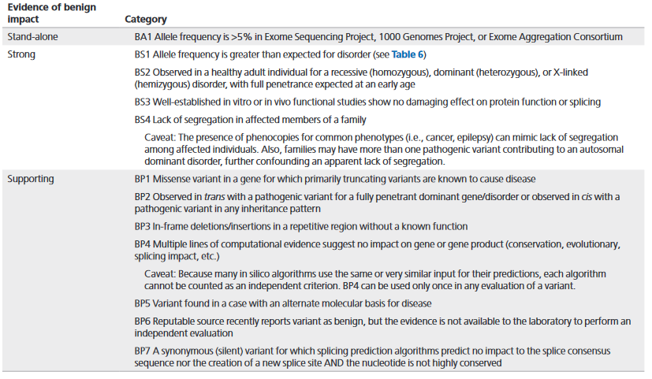
Benign Criteria

Slide 32
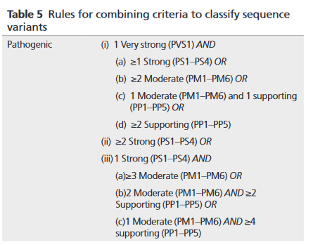
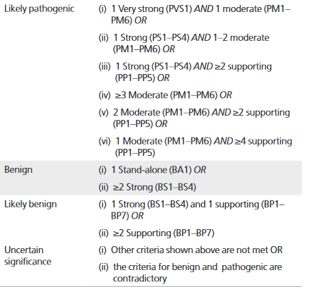
Combining Criteria

Slide 33
Source of Information
Annovar / VEP / SnpEff/ etc
Variant annotations (Computational predictors, population frequencies)
SIFT, Polyphen, CADD, etc…
Splice prediction
Exac / Gnomad
Population Frequencies
Varsome, etc
Variant annotations in web interface
UCSC genome browser
Uniprot
Clinvar
Previously classified variants

Slide 34
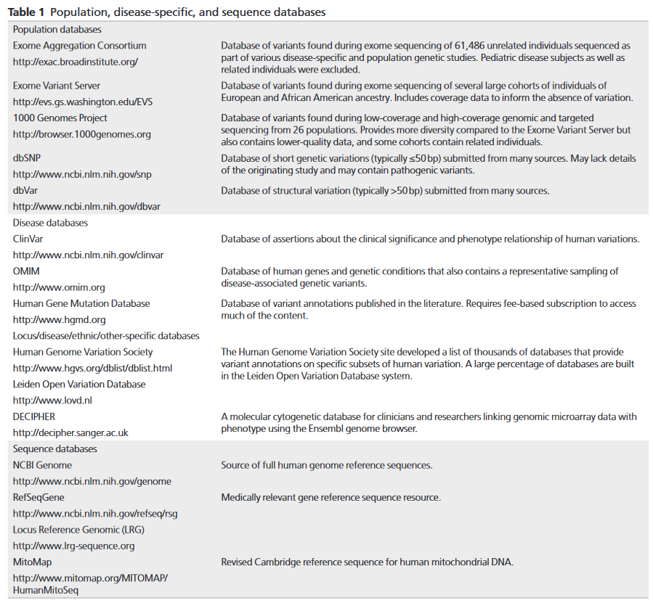
Mutation and Variant Databases

Slide 35
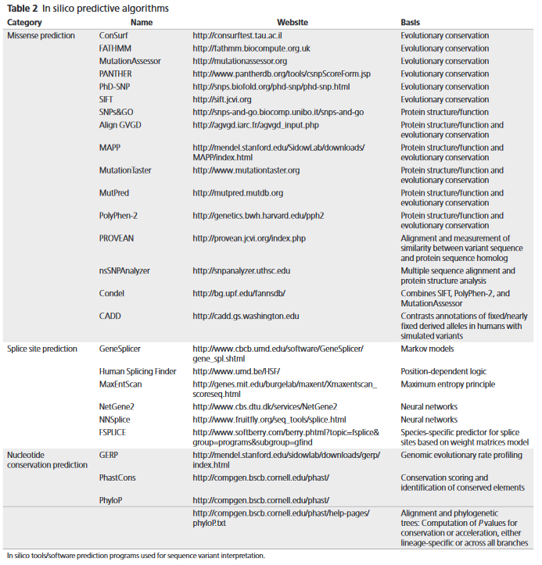
In Silico Prediction tools

Slide 36
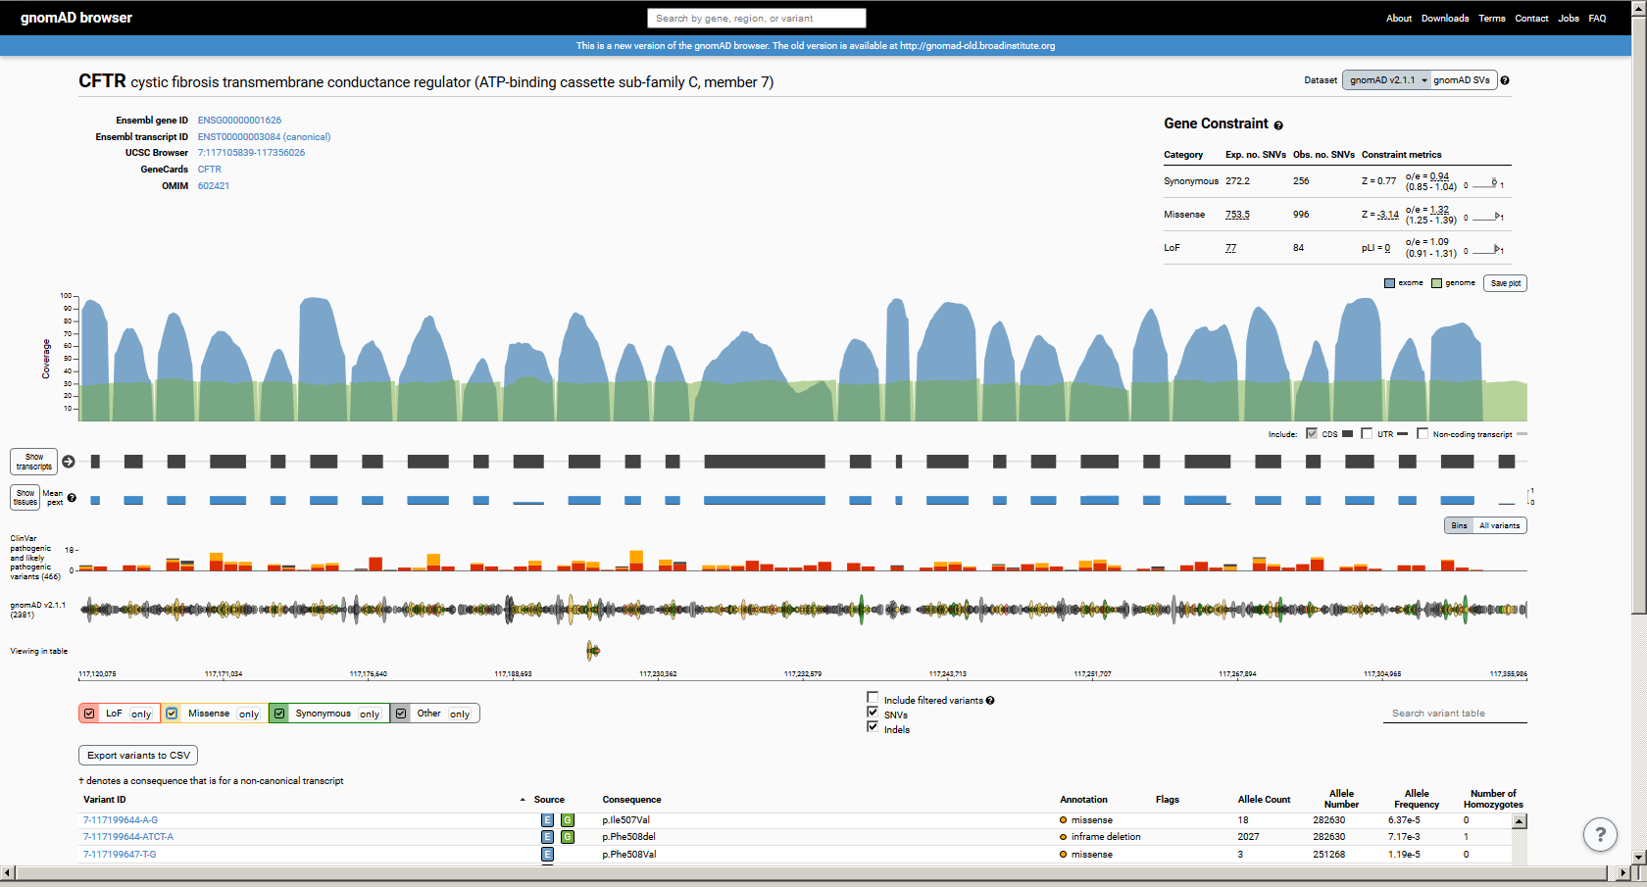
Example GNOMAD View:CFTR

Slide 37
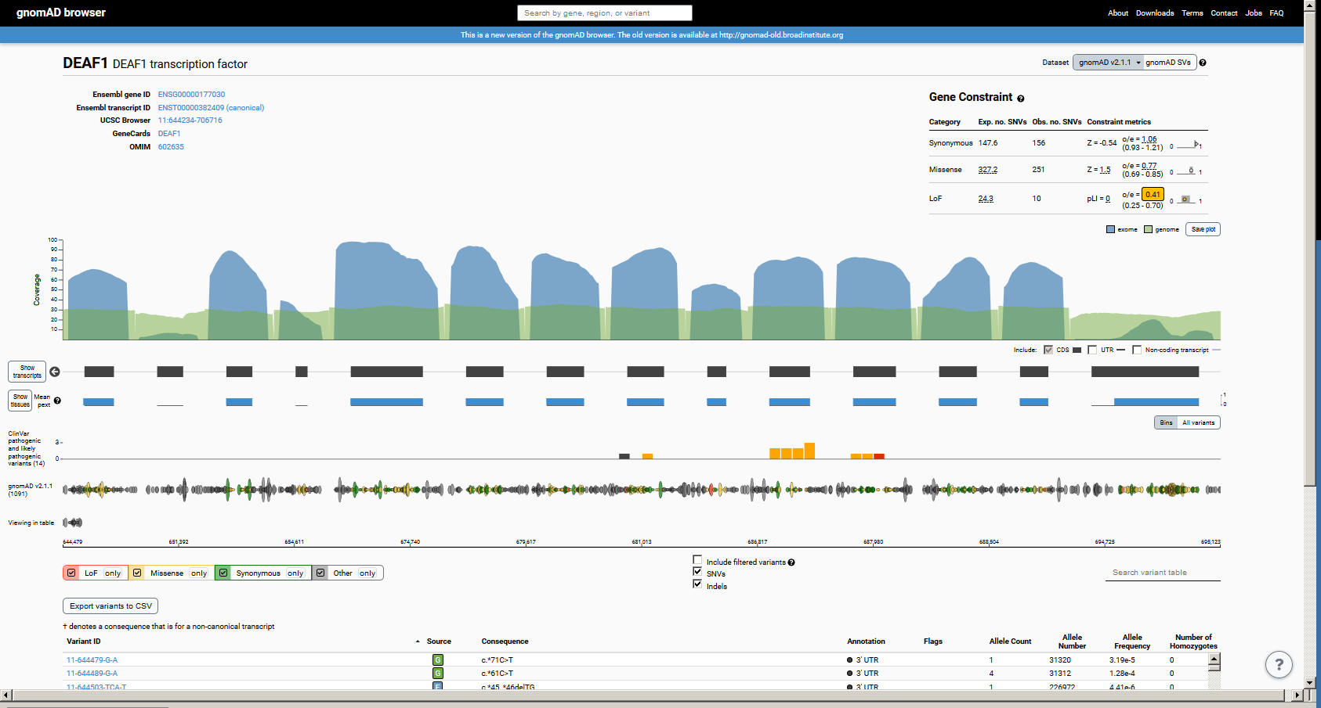
Example Gnomad View:DEAF1

Slide 38
Example Case:M2922
Clinical Features | Previous Genetic Testing | Exome de novo variants (filtering CADD > 20, ExAC freq < 0.001)
DD/ID Obesity Upslanting palpebral fissures Epicanthal folds Broad nasal bridge Micrognathia Hypotonia Sleep concerns Sleep disordered breathing Behavioral issues Volatile mood Sensory issues | Normal chromosomal microarray Normal methylation studies Negative FISH for VCF and SMS Research analysis: RAI1 sequence normal | Gene: NDN c.838G>C:p.A280P (ex 1) Variant: chr15:23931527 C>G Type: Missense CADD Phred: 25.8 Exac Frequency: 0 Comment: NDN is hemizygous in PWS, imprinted gene, mono-allelic variant expression Gene: MAPK8IP3 c.1364A>G:p.E455G (ex 11) Variant: chr16:1810461 A>G Type: Missense CADD Phred: 28.4 ExAC Frequency: 0 Comment: Not reported in human disease
Notes:
Ann: Likely other clinical features typical SMS to highlight in blue?
List PW suggested diagnosis in previous testing?
Developmental delay/intellectual disability
M2922: proband (gender, age?)
M2943
M2944

Slide 39
NDN (necdin-like protein)
One of 7 genes deleted in the Prader-Willi Syndrome contiguous gene deletion syndrome (15q11.2)
PWS is characterized by hypogonadism, hypotonia, cognitive disability, behavior problems, and hyperphagia
NDN is an imprinted gene
Only paternal allele is expressed
Not previously described in monogenic human disease but relatively constrained per ExAC
Identified variant (A280P) results in and Alanine to Proline change in a predicted alpha helix of the protein structure
Likely to disrupt protein secondary structure
Notes:
NDN: This intronless gene is located in the Prader-Willi syndrome deletion region. It is an imprinted gene and is expressed exclusively from the paternal allele. Studies in mouse suggest that the protein encoded by this gene may suppress growth in postmitotic neurons.
Cpntrained per Exac: does that mean less variants reported in Exac than expected?

Slide 40
Phasing the Variant
Nearby maternal SNP allows phasing of de novo variant to paternally inherited chromosome
Berger SI, et al. Human Genetics. 2017 Apr;136(4):409-420.

Slide 41
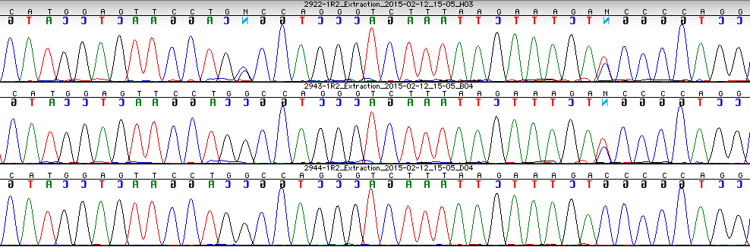
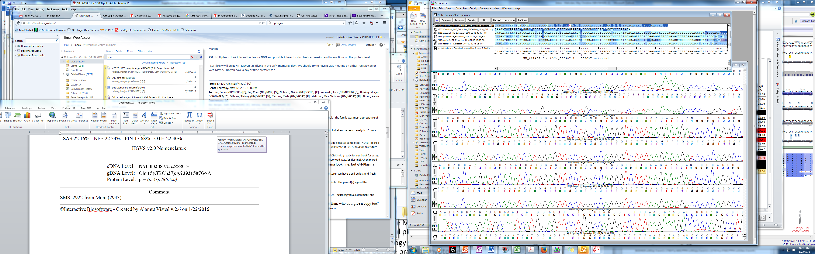
NDN Sanger Validation
(variant on paternal allele)
Maternal inherited
silent SNP
c.858C>T
de novo missense
c.838G>C
M2922
Proband
gDNA
M2943
Mom
gDNA
M2943 Dad
gDNA
Proband
cDNA

Slide 42
NDN Discussion
First de novo missense variant in this PWS region gene
Our patient’s phenotype may help explain:
Contribution of NDN deficiency to the PWS cognitive phenotype
Respiratory features in NDN knockout mouse
Exclude contribution of deficient NDN to other PWS phenotypic features
Novel c.838G>C:p.A280P missense variant requires further functional evaluation to effects on NDN gene/protein function
Can not exclude role of MAPK8IP3 variant
(May also interact with NDN… Possible digenic effect)
Notes:
Is that true? First missense variant?

Slide 43
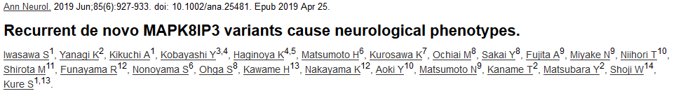
Then this happened… MAPK8IP3

Slide 44
Summary
Next generation sequencing pipelines can be tailored for germline variation, mosaic variation, small variants (SNV, indels), Copy number variants, etc.
Clinical variant interpretation Guidelines
Secondary findings

Slide 45
Thank you
Children’s Reasearch Institute Computational Biology Unit
Dr. Eric Vilain - Director of Center for Genetic Medicine Research
Dr. Hiroki Morizono - Director of CBU
Dr. Susan Knoblach
Payal Banerjee
Dr. Surajit Bhattacharya
Dr. Hayk Barseghyan

